Slide 1
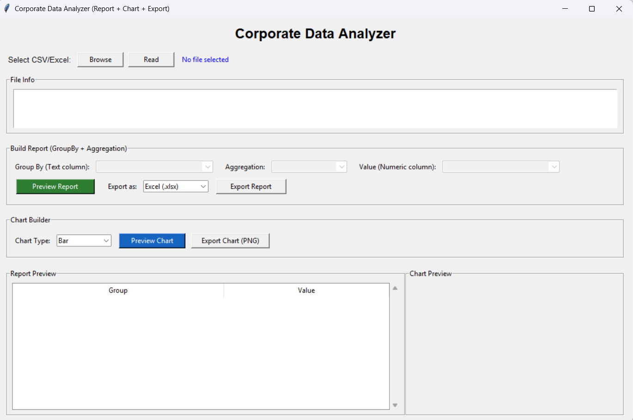
Automated Tabular Data Cleansing & Executive Report Generator
Zero-code desktop solution transforming raw operational spreadsheets into publication-ready executive insights.
Presented by Anurag Kumar Poddar | Data Analyst (Python, SQL, Power BI)

Slide 2

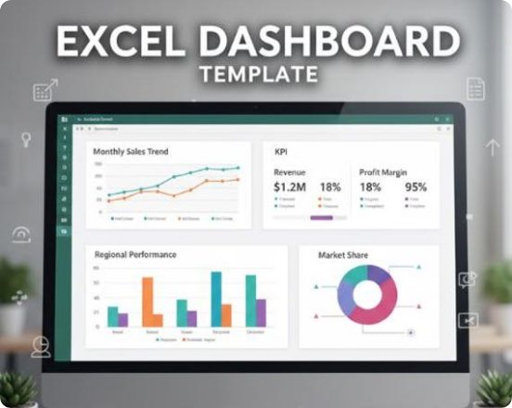
PROBLEM STATEMENT
The Corporate Reporting Bottleneck
Ad-hoc reporting stalls when raw exports require repetitive manual cleanup before basic aggregation.
String-Locked Numbers: Comma-formatted figures break formulas.
Unstandardized Text: Casing typos split identical categories.
Corrupted Records: Null entries distort statistical averages.
Manual Charting: Repetitive formatting wastes analyst hours.

Slide 3


EXECUTIVE SOLUTION
Introducing CorporateReportBuilder
Zero-Code Desktop Analytics
A unified Python desktop utility automating file ingestion, data sanitization, dynamic GroupBy aggregation, and visual export in seconds.
CSV / XLSX / XLS → Clean Report + 200 DPI Chart

Slide 4

SYSTEM WORKFLOW
End-to-End Automation Pipeline
STEP 01
STEP 02
STEP 03
STEP 04
STEP 05
File Ingestion
Type Heuristics
Sanitization
Aggregation
One-Click Export
Load CSV or Excel workbooks.
Scan columns for numeric data.
Standardize strings and strip commas.
Execute GroupBy and sort descending.
Save clean tables and charts.

Slide 5
INTELLIGENT INGESTION
Smart Heuristic Type Recognition
≥ 60%
Automated Numeric Column Detection Threshold
Scans string-typed columns upon file load and automatically unlocks numeric aggregation if 60% of records parse as valid numbers after comma removal.

Slide 6
DATA SANITIZATION
Automated Data Cleansing Engine
RAW UNCLEANSED INPUT
SANITIZED PIPELINE OUTPUT
Category Typos: " north " vs "NORTH"
Title Case Sync: Standardized to "North"
Formatted Strings: "12,500.00" stored as text
Float Coercion: Converted cleanly to 12500.0
Corrupted Cells: "N/A" or "Pending" in metrics
Null Filtering: Coerced to NaN and dropped

Slide 7


REPORTING ENGINE
Dynamic GroupBy & Aggregation
Auto-Synced Selectors
Six Core Aggregations
Formatted Live Table
Instant column mapping via dropdowns.
Sum, Mean, Median, Max, Min, Count.
Sorted descending with two-decimal precision.

Slide 8
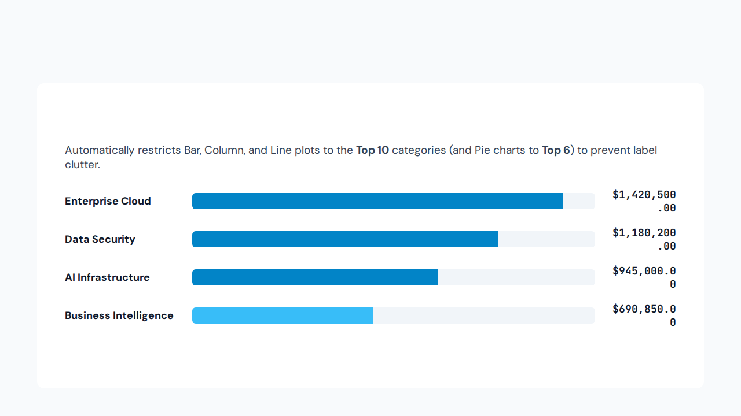
VISUAL ANALYTICS
Smart Top-N Visual Slicing

Slide 9
MODULAR DESIGN
System Architecture: CorporateReportBuilder
Method Signature | Subsystem Layer | Core Responsibility
_build_ui() | Tkinter GUI Layer | Initializes 1100x700 window, dropdowns, Treeview, and chart frame
_safe_numeric_convert() | Sanitization Engine | Strips commas from string series and coerces numbers safely
read_file() | Ingestion & Profiler | Extracts dataset dimensions and runs 60% numeric heuristic
preview_report() | Pandas GroupBy | Applies Title Case, drops nulls, aggregates, and sorts descending
preview_chart() | Matplotlib Canvas | Slices Top-N records and embeds plots via FigureCanvasTkAgg
export_report() / _chart() | File Persistence | Saves Excel/CSV summaries and 200 DPI PNG charts to source folder

Slide 10
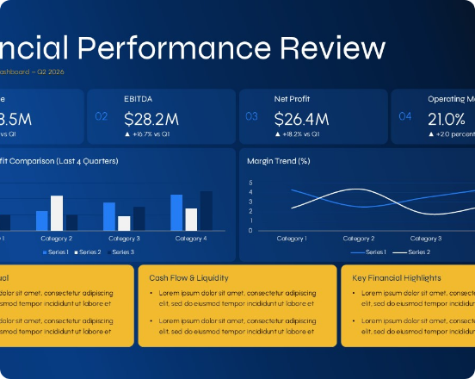
OUTPUT & IMPACT
One-Click Executive Deliverables
Boardroom-Ready Assets
Tabular Exports: Writes clean .xlsx or .csv summaries.
High-Resolution Visuals: Exports crisp 200 DPI .png charts.
Zero Path Friction: Auto-saves directly in the source directory.

Slide 11



NEXT PHASES
Future Scalability Roadmap
Multi-Level Hierarchical Grouping
Support simultaneous grouping across multiple categorical dimensions for cross-tabulated reporting.
Custom Pre-Aggregation Filtering
Add interactive date-range pickers and numeric threshold controls prior to GroupBy execution.
Automated PDF & PPTX Executive Bundling
Compile both the formatted summary table and high-DPI chart into a single downloadable executive briefing.

Slide 12
Thank You & Questions
Anurag Kumar Poddar
Data Analyst | Python • SQL • Power BI • Data Visualization

